Slide 1
Cricket Tournament management
Date : 07/11/24

Slide 2
Agenda
Project overview
Core features
Technology stack
Architecture overview
Key integrations
Future enhancements

Slide 3
Project Overview
Goal:
To create an efficient cricket tournament management platform that connects players, teams, organizers.
Objectives:
Streamline match scheduling, player registrations, and team management in a user-friendly interface.
Provide real-time updates, scores, and statistics for ongoing and upcoming matches.
Equip organizers with a comprehensive dashboard for seamless tournament coordination and management.

Slide 4
Core Features
Player Features:
Register as a player ,join teams and view Tournaments.
View Upcoming matches, schedules and team standings.
Access performance stats.
Organizer Features:
Monitor platform analytics: match views,team , player stats and tournament details.
Approve player registrations,manage teams,matches, and tournament schedules.
Other Functionalities:
Secure authentication and authorization.
Centralized dashboard for organizers to manage tournaments,teams and player registrations.

Slide 5
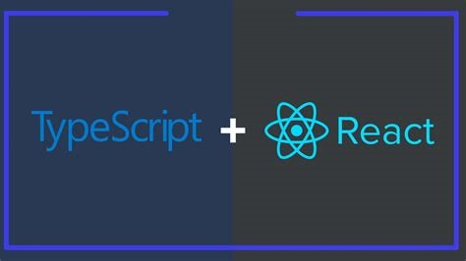

Technology Stack
Frontend:
React with TypeScript and Context API.
Material UI for UI
Backend:
Node.js and Express for REST APIs.

Slide 6

Technology Stack
Database:
MongoDB for document-based storage.
Mongoose for schema modeling.
Relationships Management: Embeds and references documents to model relationships between players, teams, and tournaments.

Slide 7
Architecture Overview
MERN Stack:
Frontend:React (for building interactive and dynamic user interfaces).
Backend: Express + Node.js (for server-side processing and API handling)
Microservices:
Player service: Manager player profiles,stats and team assignments.
Team service:Handles team information,including players , and records.
Tournament service: Manages tournament creation,schedules ,match fixtures, and results.
Flow:
Authentication and Authorization: Player,Organizer ,with session management to maintain user states.
Players: Can view Match schedules ,results , and team information.
Organizers: Can create tournaments, schedule matches and update match results.

Slide 8
Key Integrations
Firebase Authentication
Secures routes by managing user roles for Players, Organizers, ensuring each role has access to appropriate functionalities.
Cloudinary
Stores images related to tournaments, team logos, and player profiles, reducing storage load on the server while enabling efficient media management and retrieval.

Slide 9
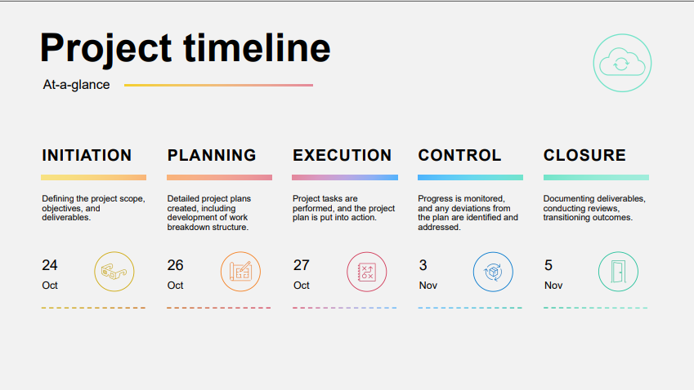

Slide 10
Future Enhancements
Payment Gateway Integration: Add secure payment options to streamline registration fees and other tournament-related transactions, making it easy for teams and players to register and pay directly through the platform.
Real-Time Chat Feature: Enable in-app chat between teams, players, and organizers to facilitate better communication for scheduling, match updates, and general inquiries.
AI-Powered Match Recommendations: Integrate an AI engine to suggest upcoming tournaments or leagues that players or teams might be interested in, based on past participation, performance, and preferences.

Slide 11
Thank You

